Slide 1


Violence Detection: Introducing a Machine Learning Based Novel Method
Presenter
Arindam Kumar Paul
Mathematics Discipline
Khulna University
Khulna-9208, Bangladesh
Team Members
Khan Anik Islam
&
Kifayat Tasnim
Mathematics Discipline
Khulna University
Khulna-9208, Bangladesh
3rd International Conference on Industrial and Mechanical Engineering and Operations Management (IMEOM), Dhaka, Bangladesh
Date : 26-27 December, 2020

Slide 2
Abstract
Human Facial Expressions plays an important role for identifying human action or intention. Facial
expressions can represents any specific action of any person and the pattern of violent behavior of
any person strongly depends on the geographic region. Here we’ve designed an automated system
by using a Convolutional Neural Network which can detect weather a person have any intention to
commit any violence or not. Here we proposed a new method that can identify violence intensions or violent behavior of any person before executing violences more efficiently by using a very little data of facial expressions before executing violence or any violent tasks. Instead of using image features which is a time-consuming and faulty method we used an automated feature selector CNN (Convolutional Neural Network) model which can capture exact facial expressions for training and then can predict that target facial expressions more accurately. Here we used only the facial data of a specific geographic region which can represent the violent and before violence facial patterns of the people of whole region.

Slide 3
Previous Works
From the literature of violence detection we can observe that no Machine learning or any other models are not being used by any industry or any individuals or any institution currently. But many scientists and processes are trying to build an Excel learning model for detecting violence since a long time ago. Actually final deduction is one of the most valuable and hardest tasks nowadays.

Slide 4
What is the Complexity
No one is going to take a selfie before or at the time of showing violence.
What is the way to collect or generate data?
It’s very hard to collect violent Image or Video samples.

Slide 5
Previous Problem Solving Strategies
Some experiments have been carried out by shooting photos using individuals acting like a violent one.
Most of them approaches video images for identifying violence.
In the case of video, scientists use a large video database for detecting the pattern of violence but violence differs from region to region culture to culture.

Slide 6
What are the points of those failures?
Data unavailability.
Lack of interpretability .
Instead of using any theory, only building models and algorithms based on data set of images or videos.
Their models are only based on data but the models are not interpretable.
Situational approach is missing from most of the study.

Slide 7
What We Did
Still now we don't know any very reliable model or algorithm that can detect violence accurately.
And we have introduced a new method for identifying violence using Machine learning and image processing techniques.

Slide 8
What We Need
We need an interpretable machine learning or deep learning model for predicting and explaining why this model is predicting its outcomes.
So we need to study social, behavioral or psychological theory for explaining the violence patterns.
Which theory can lead us to an interpretable machine learning model and can show us how the data set can be chosen for predicting violent activities.

Slide 9
Our Uniqueness
Since we can see that violence patterns as well as facial expressions and facial image and body language varies very dynamically with changing situations, regions, time, violence type and many more. Analyzing all of these is must needed in order to prevent the violence activities.

Slide 10
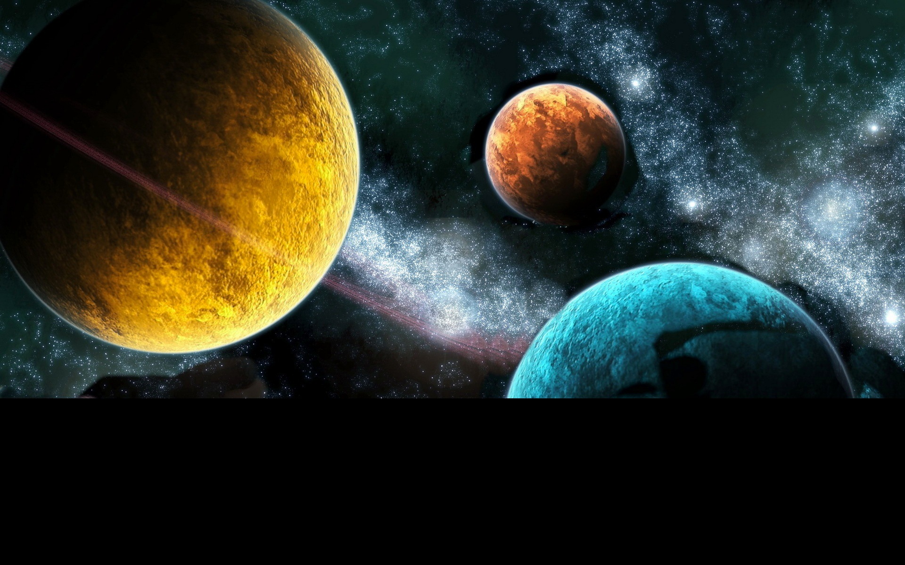
Our Strategy and Approach for Solving this Problem
Social Sciences
Statistics
Machine learning
Describe
Predict
Explain

Slide 11
Evaluation, Validation & Model Selection
Standard Working Process in Scientific Research
Model fit ≠
Validation
Explanatory power
Theoretical model
Empirical model
Data
Empirical model
Training data
Over-fitting analysis
Holdout data
Predictive power

Slide 12
Philosophy of Science
“Explanation and prediction have the same logical structure”
Hempel & Oppenheim, 1948
“It becomes pertinent to investigate the possibilities of predictive procedures autonomous of those used for explanation”
Helmer & Rescher, 1959
“Theories of social and human behavior address themselves to two distinct goals of science: (1) prediction and (2) understanding”
Dubin, Theory Building, 1969
Notes:
An explanation... Must… establish its hypothesis as more credible than its negation. Of a prediction… require only that it establish its hypothesis simply as more credible than any comparable alternative.
Helmer & Rescher (1959)

Slide 13
What is the Theory
According to the Report of US ministry of Media Control and The influence of the cinema on children and adolescents ,An annotated international bibliography by UNESCO
Media Actor’s and Highlighted Small Number of Negative Characters Influence on Human Psychology .
Media Actors influences the psychology, attitude, behaviors and other patterns of Childs and young population mostly.
According to this study, in general the heroic characters are portrayed by movies and media as a Gangster especially they all are very efficient in committing violence. The fact is movies and media portray all of their works and attitudes positively. It means a negative violent attitude or behavior of the heroic character is justified by the portrayal of the director in the media.

Slide 14
What is the Theory
According to the Report of US ministry of Media Control:
How Media Actor’s and Highlighted Small Number of Negative Characters Influence on Human Psychology ?
Media Actors influences the psychology, attitude, behaviors and other patterns of Childs and young population.
According to this study, in general the heroic characters are portrayed by movies and media as a Gangster especially they all are very efficient in committing violence. The fact is movies and media portray all of their works and attitudes positively. It means a negative violent attitude or behavior of the heroic character is justified by the portrayal of the director in the media.

Slide 15
We can take some certain decisions from the above discussion and they are:
Portrayal of minorities as a positive character influences the psychology attitude and behavior of children and youths mostly.
The pattern of violence activities of a certain geographical region can be represented by their movie actors.
A large portion of the total population and negatively affected by the justified and positively portrayed violence activities of the movie actors.
Since the children and young people are mostly infected by this media and movies so they will reflect these types of patterns in their future life though.

Slide 16
What is the point of those failures?
•Data unavailability.
•Lack of interpretability
•Instead of using any theory, only building models and algorithms based on data set of images or videos.

Slide 17
What initiative We have taken
Social Theory + Behavioral Theory + Statistical Reports
+
Image Processing for identifying patterns
+
Machine Learning For Experimenting and
Implementing

Slide 18
Building Image Dataset Based on the Theory
According to the Theory we’ve collected Images for identifying patterns of violence of south Asian Countries. We find out such some characters like media actors and they are:
Popular Media actors of a certain geographic region
Negative Characters on television of a certain geographic region.
Very Professional role model criminals of a certain geographic region.
Criminal but public hero type characters of a certain geographic region.
Such characters who become the news headline for their tactful criminal activities.

Slide 19
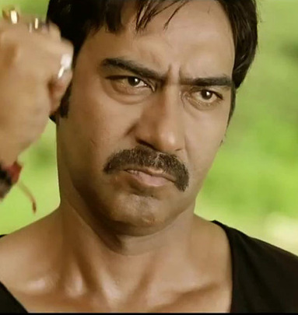
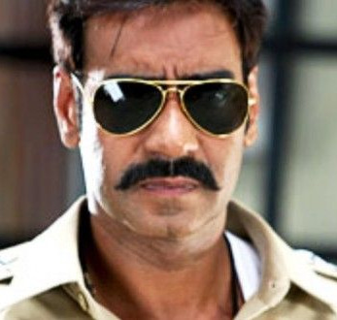
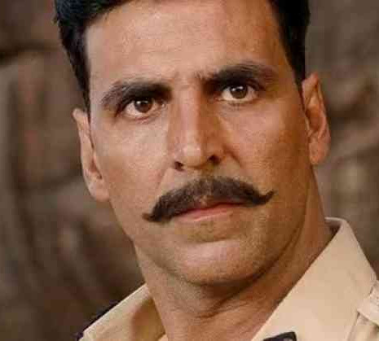
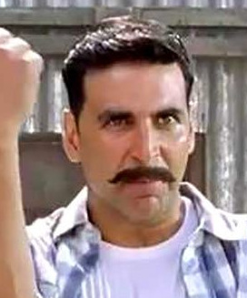

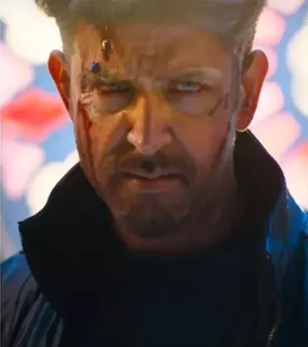
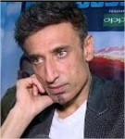
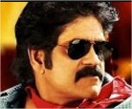
Some Examples of Our Images We Used for Predicting Violence Patterns

Slide 20
Image Processing and Visualization
We have used Histogram Oriented Gradients feature of images for visualizing the patterns of violent and nonviolent images here. The advantages of Histogram Oriented Gradients gives us a unique feature vector and orientation, Shape, Edges, Corners and Direction information about the images.
Generally Other gradient methods provide information regarding intensity illumination and color depth.

Slide 21
Image Processing and Visualization
Non-Violent Images Samples and HOG Features
Violent Images Samples and HOG Features

Slide 22
Image Processing and Visualization
Non-Violent Images Samples and HOG Features
Violent Images Samples and HOG Features

Slide 23
Explaining and Predicting
When we prove the validity of the theory visually and by conducting some statistical analysis then we use a Convolutional Neural Network model for prediction purposes.
We had collected the images from online sources, denoised and smoothed the images using wavelet.
Then we resized all the images to the same size and split it into training and validation samples.

Slide 24
Evaluating the Model
We plotted the performance of convolutional neural network models with different loss functions. For the lack of computational power and high quality data within a short time we have used 650 images as training samples and 100 images as validation samples of the model.

Slide 25
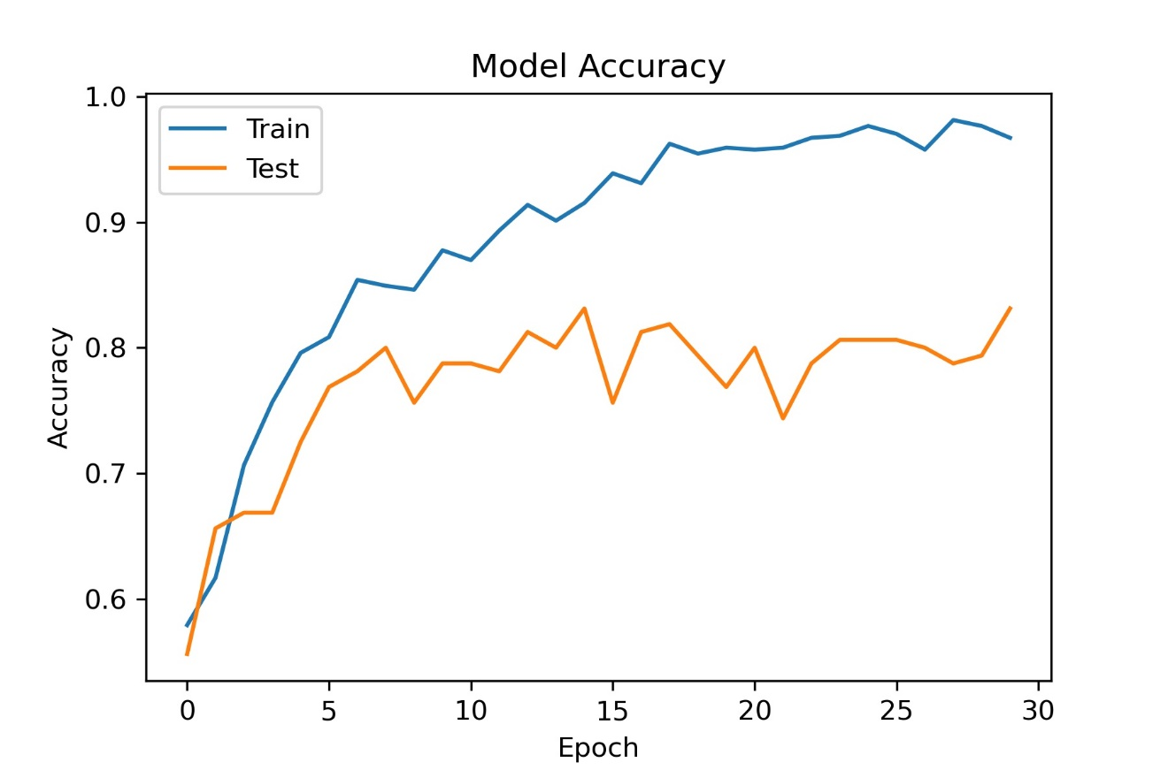
Outcome of Our Model

Slide 26
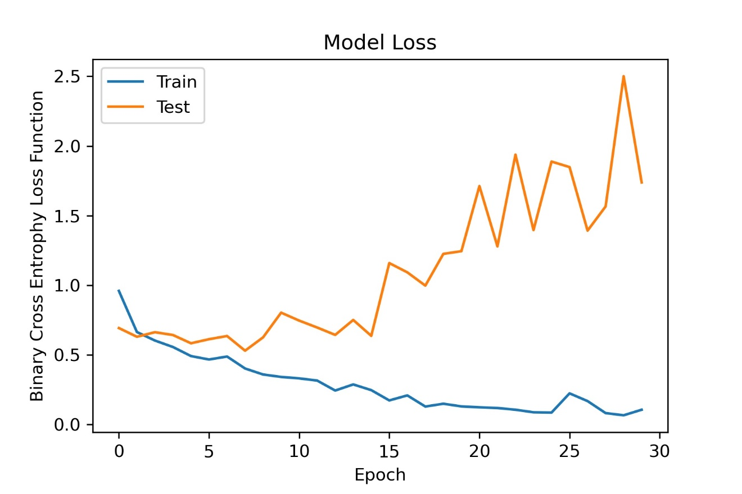
Outcome of Our Model

Slide 27
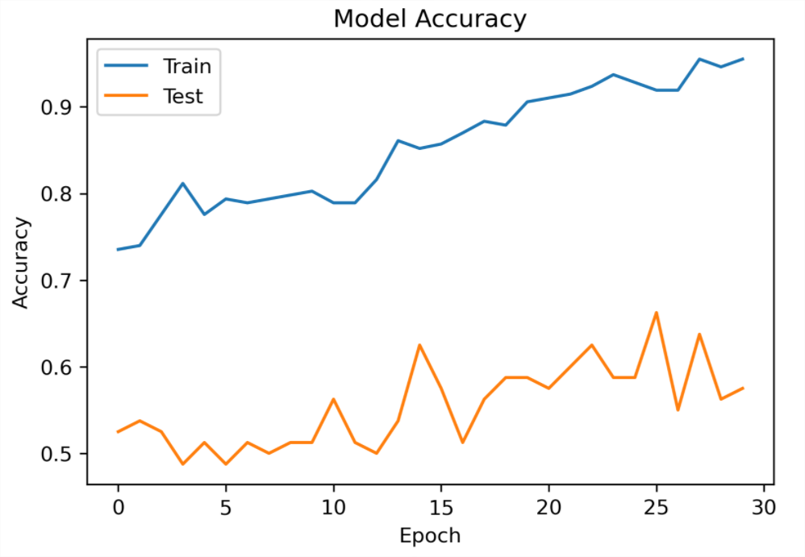
Outcome of Our Model

Slide 28
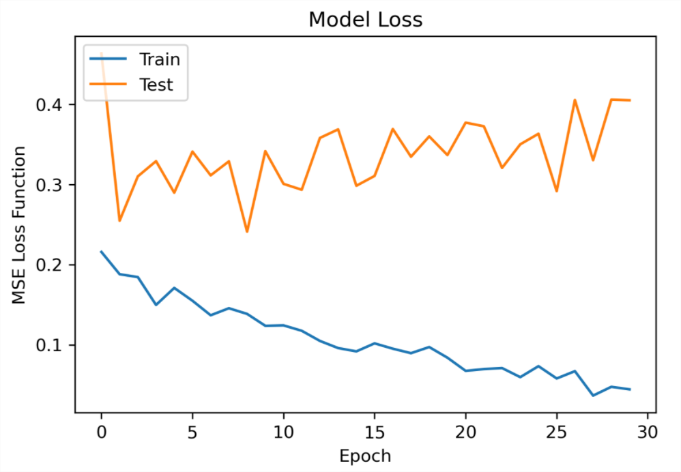
Outcome of Our Model

Slide 29
Our Evaluation Method
We have classified the images into two classes using a convolutional neural network But we have designed the prediction procedure in a different way.
Instead of taking a class like violent and nonviolent, we calculated the probability of an individual being violent. This measurement gives us an accuracy of another dimension with which we can predict images more accurately.
We have calculated all the outcomes and determine the outcome based on this probability. Firstly we have set a scale for the Violent attitude. This can be considered as a situation all approach for solving this problem. since our data is not cleaned and true accurate so we implemented this technique for gaining accurate results.

Slide 30
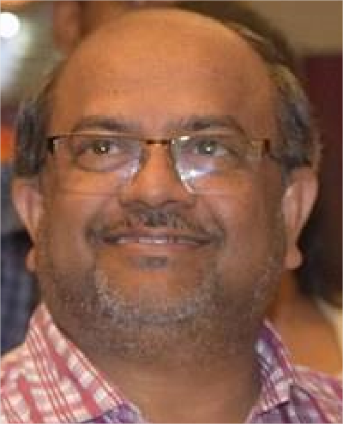
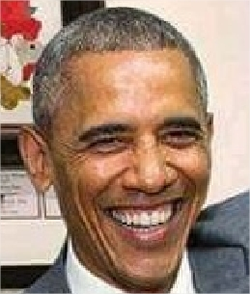
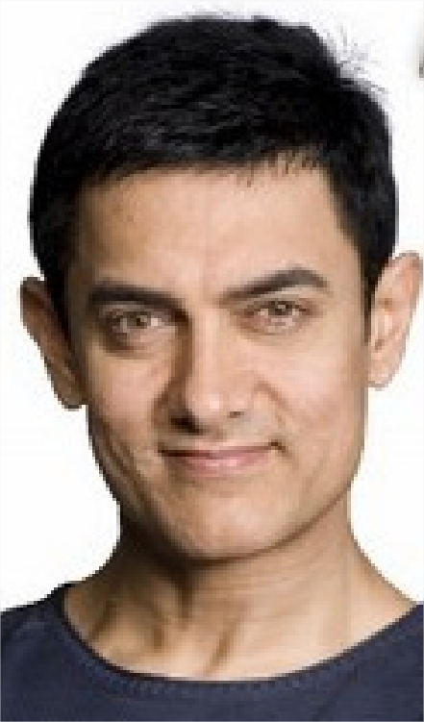
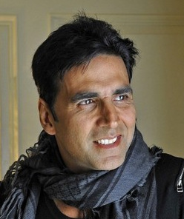



Practical Outcomes
Detected as Non-Violent Behavior
Detected as Violent Behavior

Slide 31
Evaluating Two Models

Slide 32
Prototype
We have deployed our model with all necessary codes and a small dataset on GitHub. Anyone can access the codes and experiment with these codes or develop it with other datasets. The code written in Python and the keras and tensorflow for deep learning library are used here:
https://github.com/arindampaulripon/A-Novel-Method-for-Machine-Learning-Based-Automatic-violence-Activity-Identification-System-by-Analyzin

Slide 33
References
[1] UNESCO, "The influence of the cinema on children and adolescents: An annotated international bibliography," 1998.
[2] Y. Horton, R. Price and E. Brown, "Portrayal of Minorities in the Film, Media and Entertainment Industries," Poverty & Prejudice: Media and Race, 1999.
[3] C. M. Ouverson, "The effects of color and design on audience attitude, behavior, and perception of media," 1992.
[4] N. a. B. T. Dalal, "Histograms of Oriented Gradients for Human Detection," in IEEE Computer Society Conference on Computer Vision and Pattern Recognition.
[5] X. Xu, H. Zheng and Z. G. , "SDD-CNN: Small Data-Driven Convolution Neural Networks for Subtle Roller Defect Inspection," Applied Sciences, 31 March 2019.
[6] G. Zhang, J. Kato, Y. Wang and K. Mase, "How to initialize the CNN for small datasets: Extracting discriminative filters from pre-trained model," 2015 3rd IAPR Asian Conference on Pattern Recognition (ACPR), Kuala Lumpur, 2015, pp. 479-483.

Slide 34
Thanks to All

